Slide 1
Detecting Modern Slavery
The Ospreys

Slide 2
Modern day slavery - background
The global slavery index (GSI) estimate there are over
40 mil
people in modern slavery.
Major forms of exploitation from modern day slavery:
Forced labour
Sex trade
Organ harvesting

Slide 3
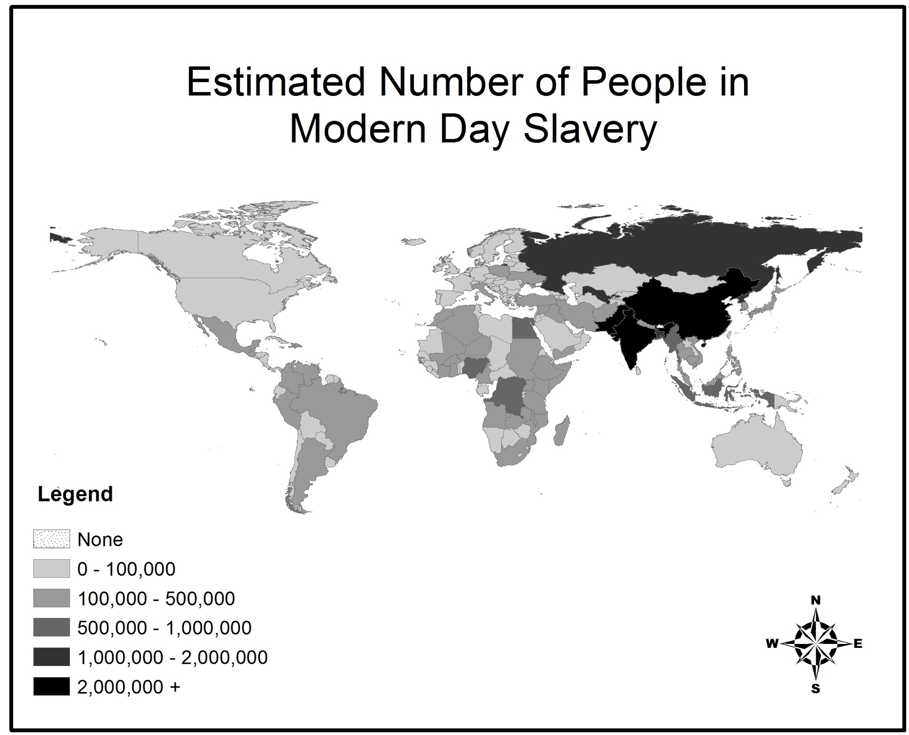
There are strong regional trends in the incidence of slavery (counts).

Slide 4
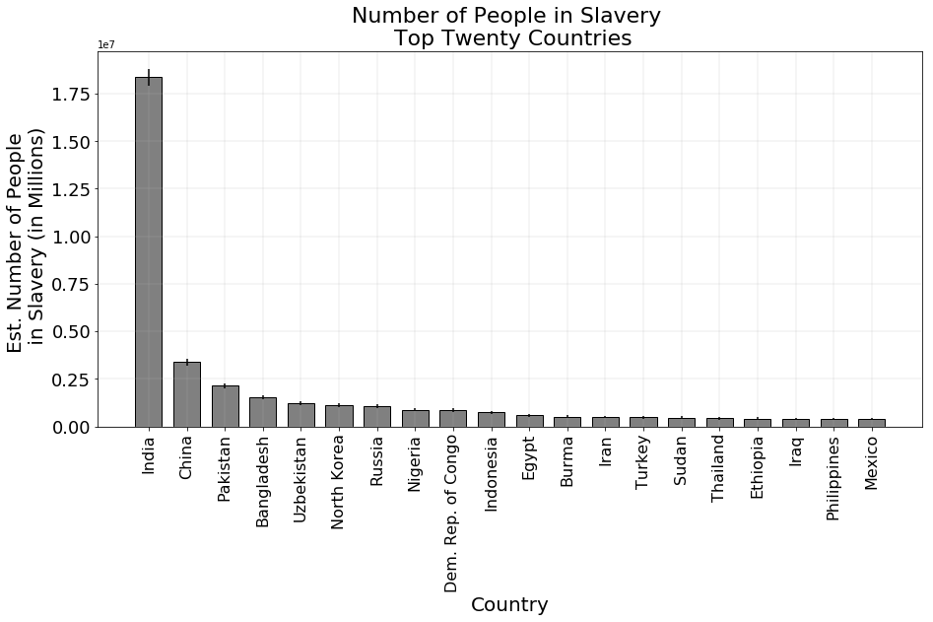
Estimate of modern day slavery by country (counts)
The largest population of modern day slaves by count are located in India

Slide 5
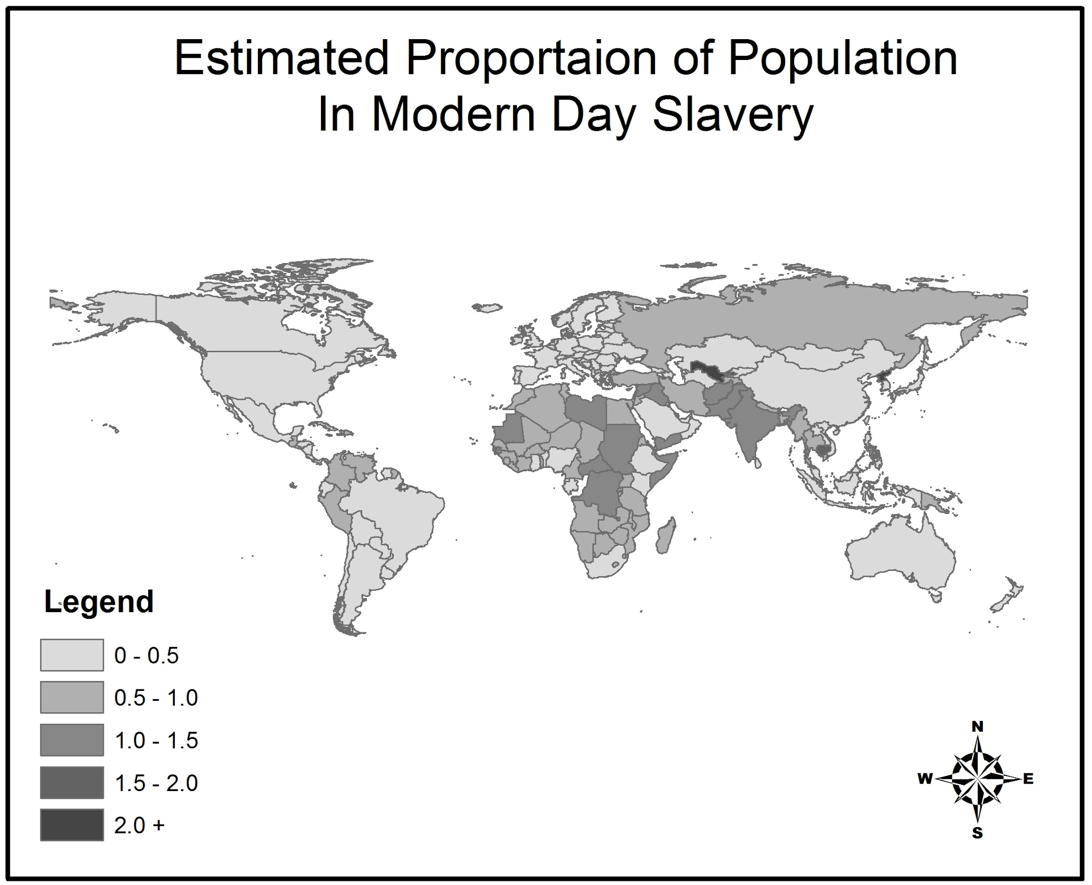
Estimated Proportion of Population in Modern Day Slavery
Africa and Asia have the highest incidence of slavery by proportion.

Slide 6
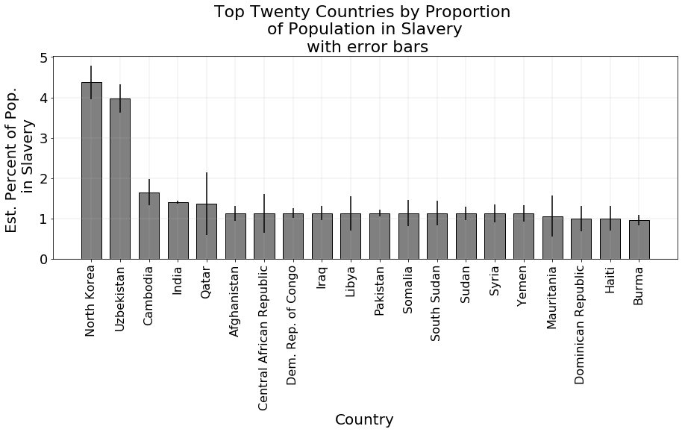
Modern day slavery proportions by country (counts)
When converting to proportion, India still ranks in the top 4; with North Korea, Uzbekistan and Cambodia also reporting high proportions. Qatar ranks fifth overall.

Slide 7
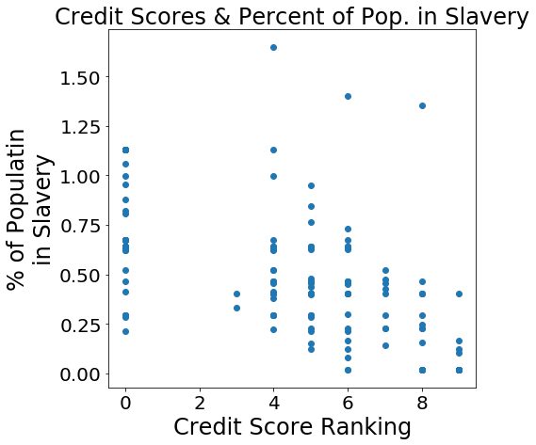
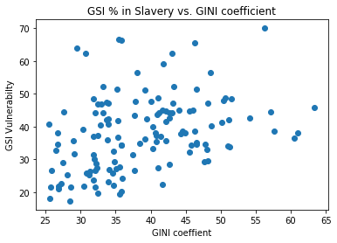
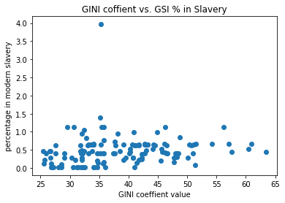
Factors providing insight into slavery incidence
GINI Coefficient, Vulnerability Index & credit scores

Slide 8
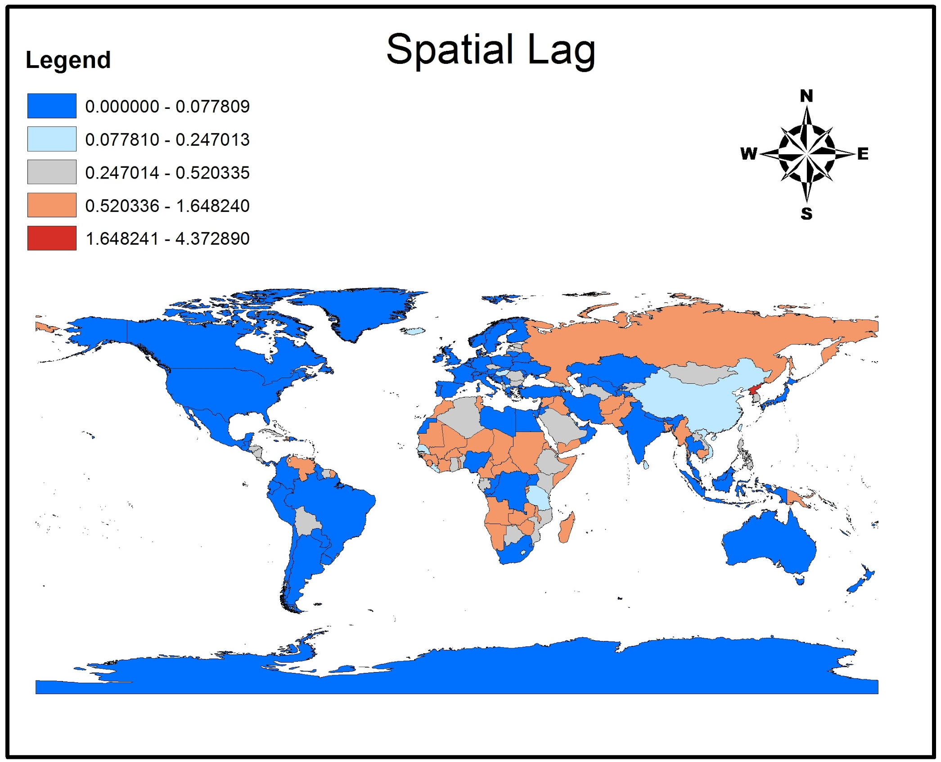
Human trafficking counts vs. occurrence of slavery
Reviewing the spatial lag of modern day slavery vs. reported trafficking counts provide insight into where to focus resources.

Slide 9
CUSP Hack-day 2017
Thank you

